Slide 1


LOUISIANA YOUNG READERS’ CHOICE
6th Grade - 8th Grade
2024 - 2025

Slide 2




LYRC IS SPONSORED BY:
Louisiana Chapters of
Delta Sigma Theta
Sorority, Inc.

Slide 3
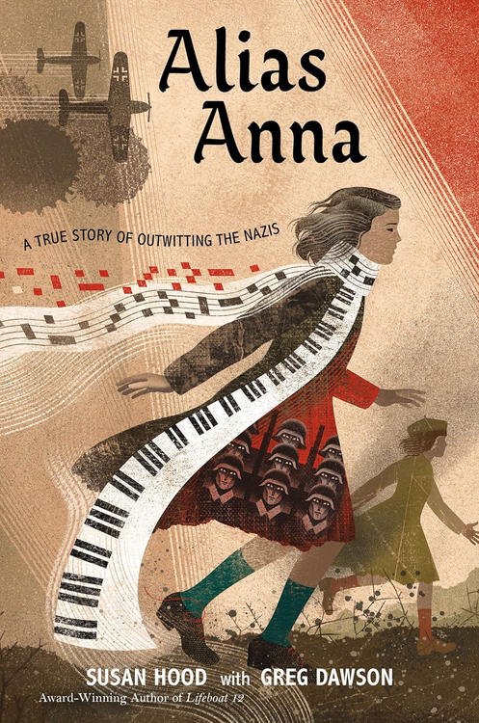
ALIAS ANNA
A TRUE STORY OF OUTWITTING THE NAZIS
Author:
Susan Hood, Greg Dawson
She wouldn’t be Zhanna. She’d use an alias. A for Anna. A for alive.
When the Germans invade Ukraine, Zhanna, a young Jewish girl, must leave behind her friends, her freedom, and her promising musical future at the world’s top conservatory. With no time to say goodbye, Zhanna, her sister, Frina, and their entire family are removed from their home by the Nazis and forced on a long, cold death march. When a guard turns a blind eye, Zhanna flees with nothing more than her musical talent, her beloved sheet music, and her father’s final plea: “I don’t care what you do. Just live.”
nonfiction | 352p
AR: MG | 5.9 | 4 pts

Slide 4
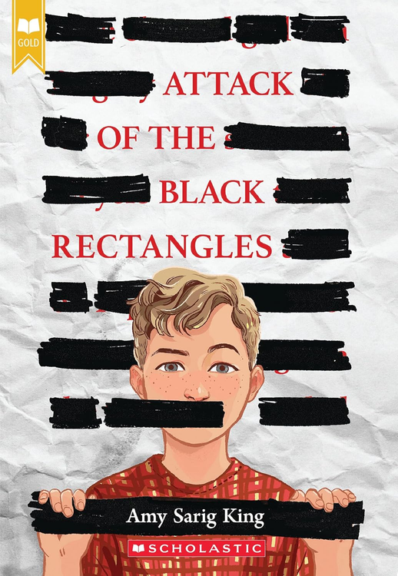
ATTACK OF THE BLACK RECTANGLES
Author:
Amy Sarig King
When Mac first opens his classroom copy of Jane Yolen's The Devil’s Arithmetic and finds some words blacked out, he thinks it must be a mistake. But then when he and his friends discover what the missing words are, he's outraged. Someone in his school is trying to prevent kids from reading the full story. But who?
Even though his unreliable dad tells him to not get so emotional about a book (or anything else), Mac has been raised by his mom and grandad to call out things that are wrong. He and his friends head to the principal's office to protest the censorship... but her response doesn't take them seriously.
So many adults want Mac to keep his words to himself. Mac's about to see the power of letting them out.
realistic fiction | 272p
AR: MG | 4.4 | 7 pts

Slide 5
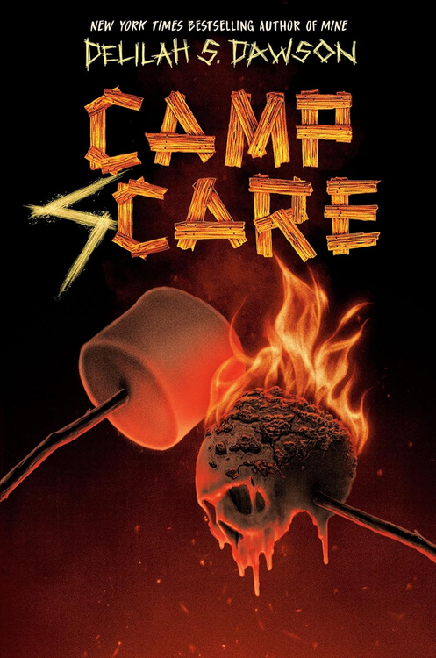
CAMP SCARE
Author:
Delilah S. Dawson
Parker Nelson can’t wait for summer camp. She’ll have fun and make amazing memories, far away from the bullies who made seventh grade unbearable.
But then something terrible happens: The mean girl who made life a living nightmare is in Parker’s cabin. Soon all the other girls turn on Parker, too—no one wants to be her friend. Except Jenny.
Jenny’s the only one who is willing to listen. The only one who understands. The only one who feels the same way Parker does: that there's a deep, dark secret to making friends and she’s the only one who doesn't know it.
But there’s something else Parker doesn’t know. Something bad happened at the camp a long time ago, and it just won’t stay buried. . . .
horror | 288p
AR: MG+ | 5.8 | 10 pts

Slide 6
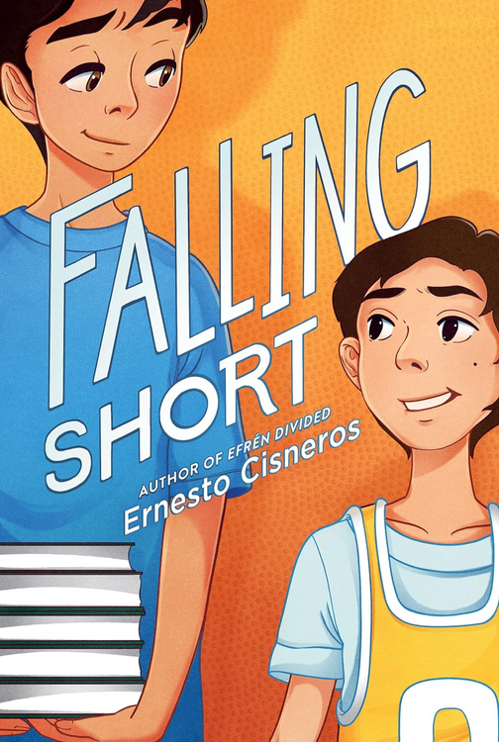
FALLING SHORT
Author:
Ernesto Cisneros
Best friends Isaac and Marco already know sixth grade is going to change their lives. But it won’t change things at home—not without each other’s help.
This year, athletically gifted Isaac plans on finally keeping up with his schoolwork. Better grades will surely stop Isaac’s parents from arguing all the time. Meanwhile, academically gifted Marco plans on finally winning his father’s approval by earning a spot on the school’s basketball team.
But will their friendship and support for each other be enough to keep the two boys from falling short?
realistic fiction | 304p
AR: MG | 4.5 | 7 pts

Slide 7
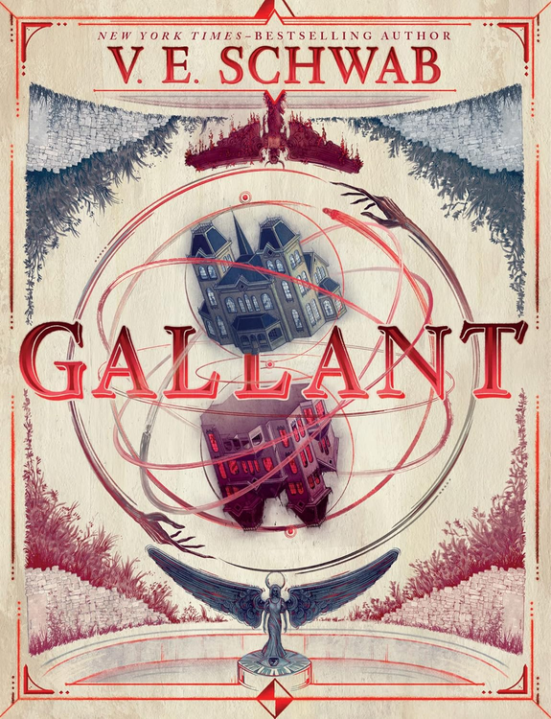
GALLANT
Author:
V. E. Schwab
Olivia Prior has grown up in Merilance School for girls, and all she has of her past is her mother’s journal—which seems to unravel into madness. Then, a letter invites Olivia to come home—to Gallant. Yet when Olivia arrives, no one is expecting her. But Olivia is not about to leave the first place that feels like home, it doesn’t matter if her cousin Matthew is hostile or if she sees half-formed ghouls haunting the hallways.
Olivia knows that Gallant is hiding secrets, and she is determined to uncover them. When she crosses a ruined wall at just the right moment, Olivia finds herself in a place that is Gallant—but not. The manor is crumbling, the ghouls are solid, and a mysterious figure rules over all. Now Olivia sees what has unraveled generations of her family, and where her father may have come from.
Olivia has always wanted to belong somewhere, but will she take her place as a Prior, protecting our world against the Master of the House? Or will she take her place beside him?
fantasy | 352p
AR: UG | 5.8 | 10 pts

Slide 8
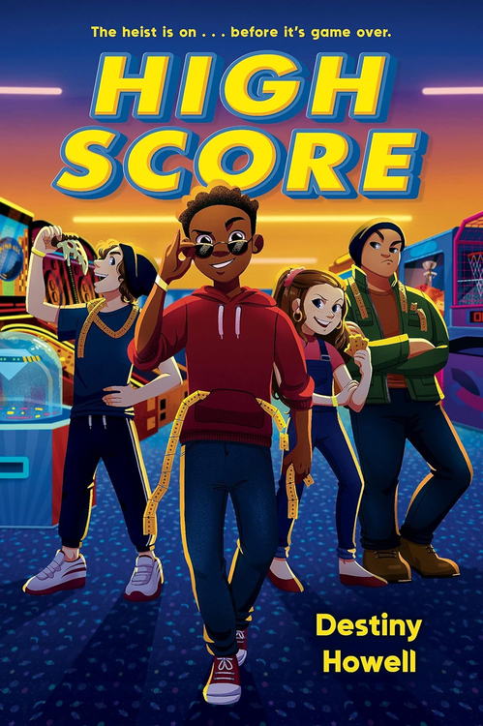
HIGH SCORE
Author:
Destiny Howell
We do this my way.
No one gets hurt.
And if I call it off, it’s off.
Got it?
My name’s Darius James—but everyone calls me DJ. At my old school, I was the go-to guy for all kinds of tricky problems that needed creative solutions. But at my new school, Ella Fitzgerald Middle, I’m just trying to blend in.
Well, I was, anyway, until my best friend, Conor, got himself transferred to the Fitz too. Now Conor owes 100,000 arcade tickets to the biggest bully around—and he only has two weeks to make it happen. Impossible? Not with my head in the game.
realistic fiction | 304p
AR: MG | 4.3 | 7 pts

Slide 9
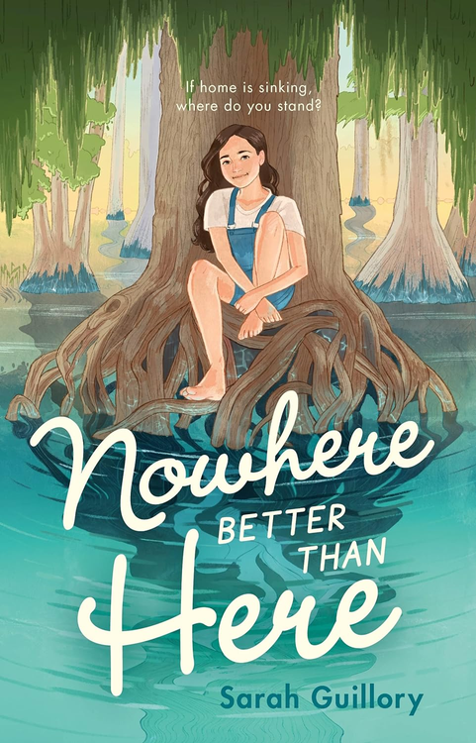
NOWHERE BETTER THAN HERE
Author:
Sarah Guillory
For thirteen-year-old Jillian Robichaux, three things are sacred: bayou sunsets, her grandmother Nonnie’s stories, and the coastal Louisiana town of Boutin that she calls home.
When the worst flood in a century hits, Jillian and the rest of her community band together as they always do—but this time the damage may simply be too great. After the local school is padlocked and the bridges into town condemned, Jillian has no choice but to face the reality that she may be losing the only home she’s ever had.
But even when all hope seems lost, Jillian is determined to find a way to keep Boutin and its indomitable spirit alive. With the help of friends new and old, a loveable golden retriever, and Nonnie’s storytelling wisdom, Jillian does just that in this timely and heartfelt story of family, survival, and hope.
realistic fiction | 256p
AR: MG | 4.5 | 8 pts

Slide 10
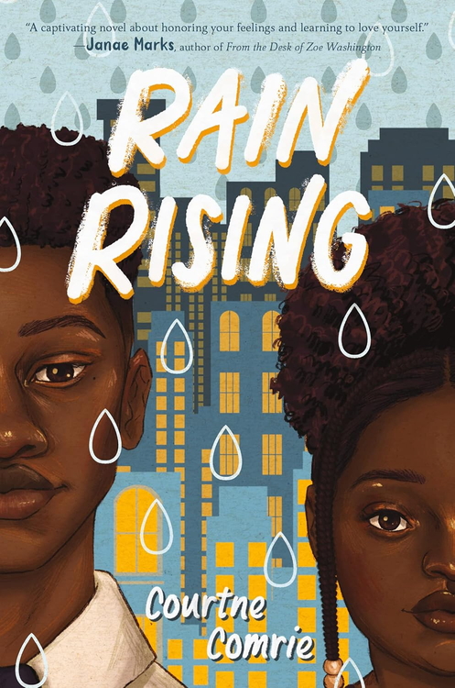
RAIN RISING
Author:
Courtne Comrie
Rain is keeping a big secret from everyone around her: She's sad. All the time.
Xander, her older brother, is an all-star student athlete and a superhero to Rain since their dad is not around. But even he can’t help Rain with her dark thoughts. Rain hates the way she looks, and she feels inferior to her best friend, Nara, who’s skinny and got more money, lighter skin, and hair that curls.
When Xander is the victim of a hate crime, things take a turn for the worse. Xander stops speaking to everyone, including Rain, whose dark thoughts turn into action.
Rain’s secret battle puts her life on the line. But when her favorite teacher invites her to an after-school circle group, Rain finds friends and the courage to help herself and her family heal. Like the rain, she is both gentle and a force, and though she faces many storms in her life, she finds the strength to rise again.
realistic fiction | 336p
AR: MG+ | 3.6 | 5 pts

Slide 11
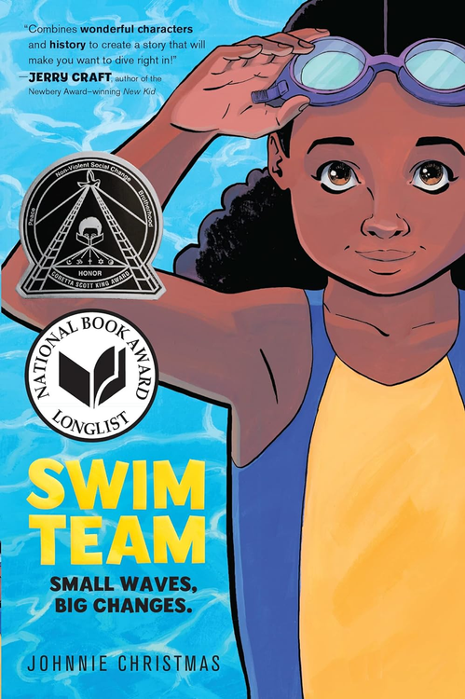
SWIM TEAM
Author:
Illustrator:
Johnnie Christmas
Johnnie Christmas
Bree can’t wait for her first day at her new middle school, Enith Brigitha, home to the Mighty Manatees—until she’s stuck with the only elective that fits her schedule, the dreaded Swim 101.
The thought of swimming makes Bree more than a little queasy, yet she's forced to dive headfirst into one of her greatest fears. Lucky for her, Etta, an elderly occupant of her apartment building and former swim team captain, is willing to help.
With Etta’s training and a lot of hard work, Bree suddenly finds her swim-crazed community counting on her to turn the school’s failing team around. But that’s easier said than done, especially when their rival, the prestigious Holyoke Prep, has everything they need to leave the Mighty Manatees in their wake.
graphic novel | 256p
AR: MG | 2.6 | 1 pt

Slide 12
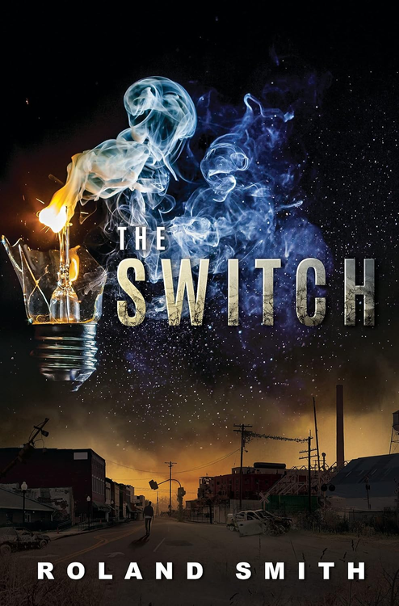
THE SWITCH
Author:
Roland Smith
On the morning of Henry Ludd's thirteenth birthday, the power goes out. No phones, no news, and planes are literally falling out of the sky. Henry's father was away from the family farm and he has not returned. It's worrisome as people descend into lawlessness.
Four months later, the electricity still hasn't come back. While Henry's family is protected in their walled compound with wind turbines fueling their electricity, the rest of their area has suffered. Henry's father still hasn’t been found. Determined to find him, Henry ventures out with a trading crew to the zoo where his dad was last seen. After the truck is hijacked and Henry is left behind, he's forced to travel alone through the unruly world of the Switch. But his journey home will lead him to cross paths with the people who took his dad and have been trying to take over his family's land and resources ever since.
survival | 304p
AR: MG | 4.4 | 10 pts

Slide 13
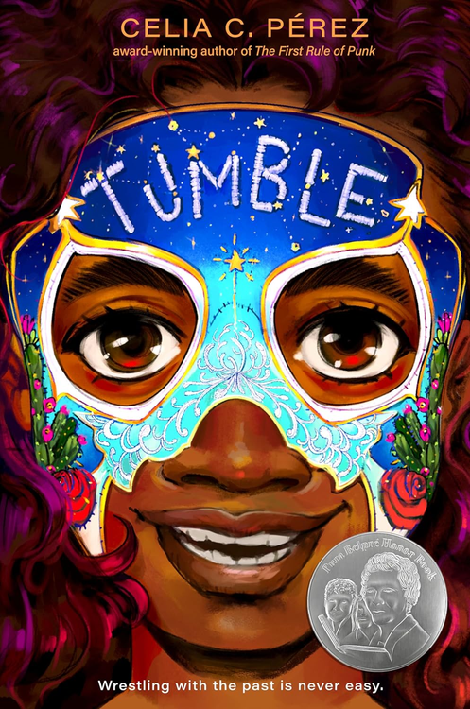
TUMBLE
Author:
Celia C. Pérez
Twelve-year-old Adela “Addie” Ramírez has a big decision to make when her stepfather proposes adoption. Addie loves Alex, the only father figure she’s ever known, but with a new half brother due in a few months and a big school theater performance on her mind, everything suddenly feels like it’s moving too fast. She has a million questions, and the first is about the young man in the photo she found hidden away in her mother’s things.
Addie’s sleuthing takes her to a New Mexico ranch, and her world expands to include the legendary Bravos: Rosie and Pancho, her paternal grandparents and former professional wrestlers; Eva and Maggie, her older identical twin cousins who love to spar in and out of the ring; Uncle Mateo, whose lucha couture and advice are unmatched; and Manny, her biological father, who’s in the midst of a career comeback. As luchadores, the Bravos’s legacy is strong. But being part of a family is so much harder—it’s about showing up, taking off your mask, and working through challenges together.
realistic fiction | 368p
AR: MG | 4.5 | 11 pts

Slide 14
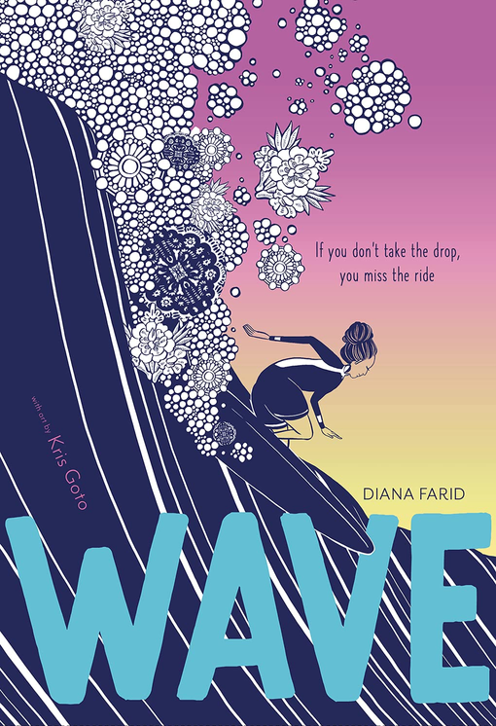
WAVE
Author:
Illustrator:
Diana Farid
Kris Goto
Thirteen-year-old Ava loves to surf and to sing. Singing and reading Rumi poems settle her mild OCD, and catching waves with her best friend, Phoenix, lets her fit in—her olive skin looks tan, not foreign. But then Ava has to spend the summer before ninth grade volunteering at the hospital, to follow in her single mother’s footsteps to become a doctor. And when Phoenix’s past lymphoma surges back, not even surfing, singing, or poetry can keep them afloat, threatening Ava’s hold on the one place and the one person that make her feel like she belongs. With ocean-like rhythm and lyricism, Wave is about a girl who rides the waves, tumbles, and finds her way back to the shore.
historical fiction | 320p
AR: MG+ | 3.7 | 3 pts

