Slide 1
State of the
State Library
Rebecca Hamilton
State Librarian
Louisiana Library Association Annual Conference
March 21-23, 2012

Slide 2
AGENDA
Budget
Overview of Current Budget
2012 – 2013 Projected Budget
Concerns & Issues
Accomplishments
Initiatives
BTOP/Stimulus Grant Update

Slide 3
SLOL CURRENT BUDGET OVERVIEW Total Budget FY11-12
State Funding $5,086,897
Self-generated $40,905
Federal Funding $5,890,404
Total Budget $11,018,206

Slide 4
CURRENT FY 2011-12 BUDGET

Slide 5
OTHER CHARGES HIGHLIGHTS
ILL $168,400
OCLC Cataloging $48,000
Databases $650,000
LD Workshops $0
Bibliostat $7,000
KLAS $18,000
Children’s $5,000

Slide 6
OTHER CHARGES CONT’D
IMLS Leadership Grant $60,000
Horizon $16,000
State Aid $736,334
Internet $380,000
Utah Braille $16,000
Books & Materials $100,000
Total Budget $2,204,734

Slide 7
SLOL OPERATING BUDGET

Slide 8
SLOL STAFFING

Slide 9
FY 11-12 SLOL BENEFITS TO LIBRARIES
Databases $650,000
ILL $168,400
Lanter $240,000
Internet $380,000
State Aid $736,334
Bibliostat $7,000
IMLS Leadership Grant $60,000
BTOP $3,239,208
Workshops & Children $5,000
Total $5,478,942

Slide 10
BUDGET CONCERNS FOR FY 2012-2013
State Aid is ZERO
BTOP Stimulus funding makes our budget look larger
Not meeting MOE - 4th year in a row

Slide 11
ACCOMPLISHMENTS

Slide 12
The return of the …

Slide 13
OTHER CENTER FOR THE BOOK PROGRAMMING
Letters About Literature
Louisiana Writer Award

Slide 14
E-books
Collections
Britannica
Gale: Small Business Collection
Credo Reference
EBSCO e-books and audiobooks
MARC records -- coming

Slide 15
SPECIAL SERVICES FACES OLD AND NEW
New Name
SBPH to TBBL (Talking Books and Braille Library). The emphasis of the name is on the services provided and not on the people served.
Digital books account for almost half of overall TBBL circulation; and,
BARD accounts for 10% of circulation.

Slide 16
OTHER ITEMS
Statewide Staff Day
IT Staff Technology Visits
More Online Training
Supervision & Management for Support Staff (LSSCP – Certified)

Slide 17
COLLABORATIVE SUMMER READING PROGRAM
Children – Dream Big – READ!
Teens – Own the Night
Adults – Between the Covers
CSLP 2011
88,402 children and teens participated.
252,594 attended related programs.

Slide 18
2012 CHILDRENS’ SUMMER READING PROGRAM

Slide 19
2012 TEEN SUMMER READING PROGRAM

Slide 20
2012 ADULT READING PROGRAM

Slide 21
LOUISIANA YOUNG READERS' CHOICE AWARD
25,000 students voted in 2012 for their favorite book.
This year's participants read almost 75,000 books.

Slide 22
This year's winners…
3-5th Grade
6-8th Grade
The Dunderheads by Paul Fleischman
11 Birthdays by Wendy Mass

Slide 23
LOUISIANA TEEN READERS' CHOICE AWARD
Hate List by Jennifer Brown

Slide 24
LOUISIANA TEEN READERS' CHOICE AWARD 2012
This is the new high school component for students in grades 9-12.
The State Library has a dedicated web site especially for teens. The site has summaries, guides and videos of the nominees: http://www.state.lib.la.us/ltrc2012/ .
First ballots will be cast February 2012.

Slide 26
BTOP Grant Update

Slide 27
Louisiana Libraries: Connecting People to their Potential
Funded by $8.8M competitive BTOP grant
Statewide workforce training – over 2,700 classes over 3 years in computer applications and soft skills
HomeworkLouisiana
Jobs & career resources
Assistive Technology
Laptops to check out

Slide 28
Training, Consulting & Laptops
Through December 2011
3043 classes
16,957 attendees
Most popular:
MS Word, level 1
Computer Foundations
Into to Windows
Home Wireless and Home Security
Laptops averaging 334 checkouts per week

Slide 29
Accessibility Technology
Technology
Topaz CCTV Reader
Workstation, 24” monitor, ergonomic keyboard, trackball mouse
MAGic software – 1 license per building
JAWS – 1 license per parish
Deliveries to date: 61
Trained: 137 staff

Slide 30
Learning Express Basic Computer Skills
Getting Started with Computers
Intro to Computers
Intro to Windows
The Computer in Action
Getting Started with the Internet
Intro to the Internet
Email & Chat
Social Networks & Online Communities
Web Applications and Internet Security
Still have the testing module and computer applications module.

Slide 31
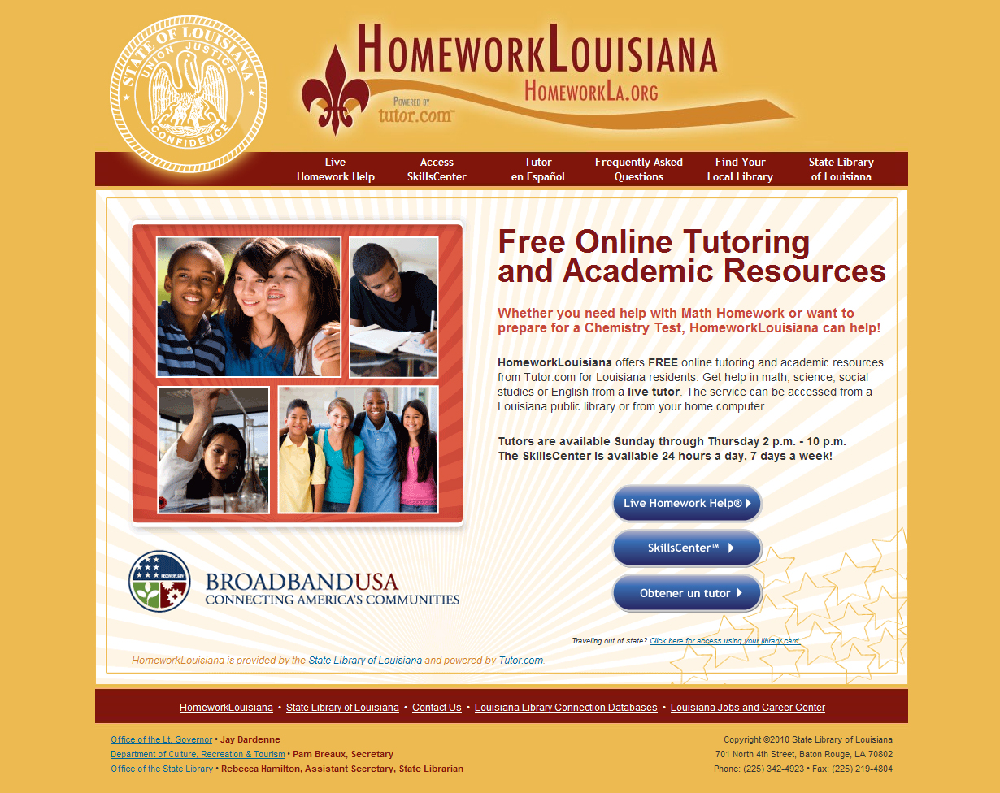

Slide 32
HomeworkLouisiana
51,000 Tutoring sessions so far
Highest Usage:
East Baton Rouge
Calcasieu
St. Tammany
Most popular topics:
Algebra 1
Algebra 2
Geometry
Most used by Grades:
11th
9th
10th
HomeworkLa.org

Slide 34
WorldBook and LA Jacc
WB
Discover
Online for Kids
Online Information Finder
Online Reference Center
Spanish language resources
Louisiana Jobs and Career Center (LA JaCC)
195,000 hits

Slide 35
WE’D LIKE TO HEAR FROM YOU Our Questions:
What more can we do for you?
What can we do better?
What should we stop doing?
Grade our services, response time and professionalism
Share your vision with us
Give us feedback on our common goals

Slide 36
State Library of Louisiana
701 North 4th Street Baton Rouge, LA 70802
Phone: (225) 342-4923 • Fax: (225) 219-4804
www.state.lib.la.us
rhamilton@slol.lib.la.us

