Slide 1


LOUISIANA YOUNG READERS’ CHOICE
Kindergarten - 2nd Grade
2024 - 2025

Slide 2




LYRC IS SPONSORED BY:
Louisiana Chapters of
Delta Sigma Theta
Sorority, Inc.

Slide 3

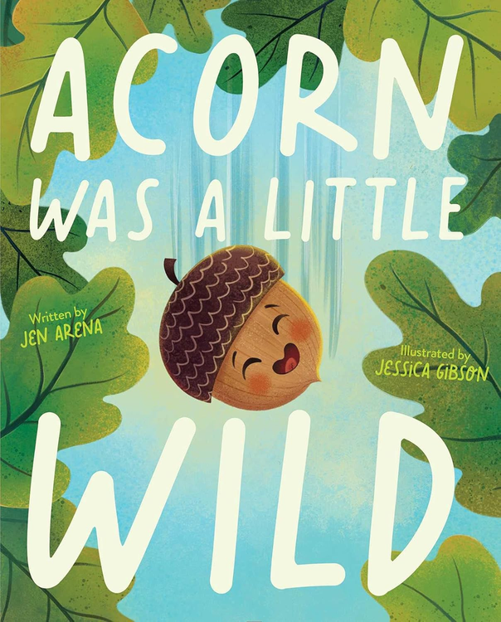
ACORN WAS A LITTLE WILD
Author:
Illustrator:
Jen Arena
Jessica Gibson
Acorn is a little wild, and from his oak tree perch, he longs for adventure. When he’s the first of his friends to jump off the oak tree, he’s on his way into the wide world, full of new experiences that fill his little heart with excitement!
But when a squirrel buries Acorn deep underground, the thrill-seeking Acorn finds himself forced to stay still, in the darkness, for a long time. To turn this biggest setback into a wild adventure, Acorn may have to change from the inside out.
picture book fiction | 40p
AR: LG | 3.2 | 0.5 pts

Slide 4
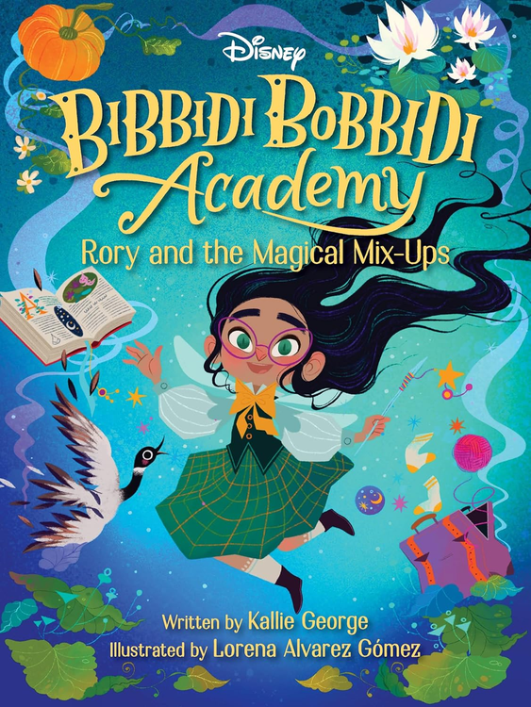
BIBBIDI BOBBIDI ACADEMY
RORY AND THE MAGICAL MIX-UPS
Author:
Illustrator:
Kallie George
Lorena Alvarez Gómez
Rory Spellington is fluttering with excitement as she begins her first year at the prestigious Bibbidi Bobbidi Academy!
But fairy godmothering might not be as easy as she thought, especially because Rory has always struggled with spelling—magic spelling that is. During her first week at the academy, Rory discovers there is more to being a good fairy godmother than magic, and she will learn she has her own set of talents that set her apart.
fantasy | 80p
AR: LG | 3.0 | 0.5 pts

Slide 5
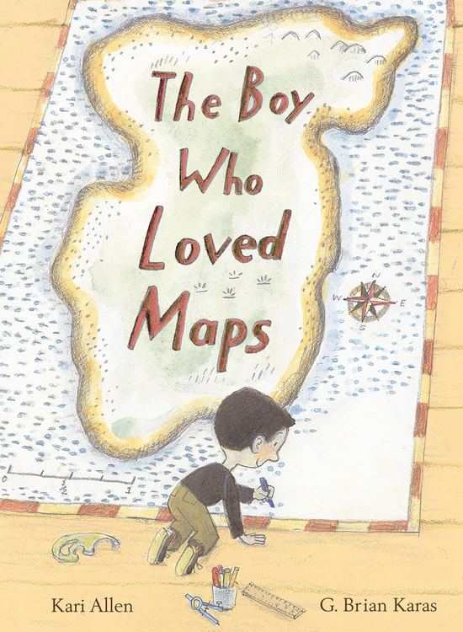
THE BOY WHO LOVED MAPS
Author:
Illustrator:
Kari Allen
G. Brian Karas
The Mapmaker loves maps. He loves to collect them, to study them, and most of all, he loves to make them. But when a girl asks for a map of a perfect place, the Mapmaker is perplexed. She wants a map to a toes-in-the-sand-warm, X-marks-the-spot-place filled with treasures, where it smells like her birthday and she can zip around like a dragonfly. Surely, a place that is all of these things can't exist...can it? Well, after a fun-filled day of exploring the neighborhood, the Mapmaker will discover that the perfect place--home--has been right in front of him all along.
picture book fiction | 44p
AR: LG | 3.7 | 0.5 pts

Slide 6

CHESTER VAN CHIME WHO FORGOT HOW TO RHYME
Author:
Illustrator:
Avery Monsen
Abby Hanlon
There once was a youngster named Chester van Chime
Who woke up one day and forgot how to rhyme.
Chester loved rhyming, in poem or song.
It always felt right, but today it felt...not right. VERY not right.
Chester van Chime is usually the BEST at rhyming. He can normally tell you all about cats wearing hats and snails delivering mail, but today, something has changed. Today there's no dog on a log. No duck in a truck. Just a Pomeranian on a sideways tree and a waterfowl in a full-size pickup. What's a kid to do?!
picture book nonfiction | 40p
AR: LG | 2.8 | 0.5 pts

Slide 7

GIBBERISH
Author:
Illustrator:
Young Vo
Young Vo
It's Dat's first day of school in a new country! Dat and his Mah made a long journey to get here, and Dat doesn't know the language. To Dat, everything everybody says – from the school bus driver to his new classmates – sounds like gibberish. How is Dat going to make new friends if they can't understand each other?
Luckily there's a friendly girl in Dat's class who knows that there are other ways to communicate, besides just talking. Could she help make sense of the gibberish?
picture book fiction | 44p
AR: LG | 1.8 | 0.5 pts

Slide 8

GIGI AND OJIJI
Author:
Illustrator:
Melissa Iwai
Melissa Iwai
Gigi can’t wait for her Ojiji—Japanese for grandpa—to move in. Gigi plans lots of things to do with him like playing tag, reading books, and teaching Roscoe, the family dog, new tricks. But her plans don’t work out quite the way she’d hoped. And her grandpa doesn’t seem to like Roscoe. Will Gigi find a way to connect with her Ojiji?
early reader | 32p
AR: LG | 2.3 | 0.5 pts

Slide 9
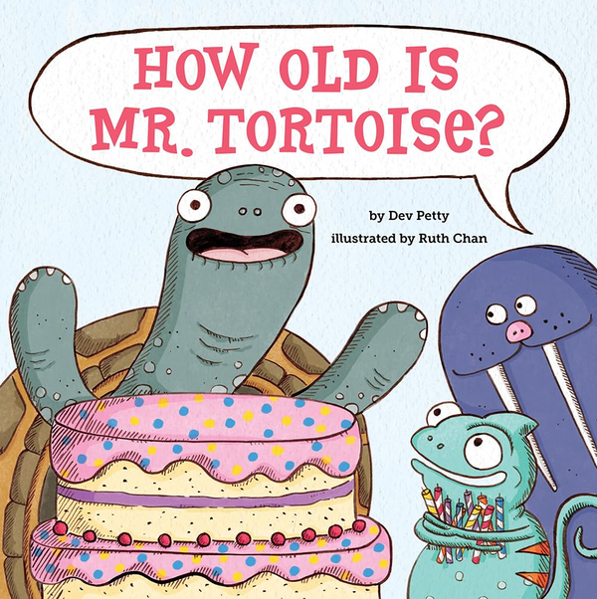
HOW OLD IS MR. TORTOISE?
Author:
Illustrator:
Dev Petty
Ruth Chan
It’s Mr. Tortoise’s birthday, and he can’t wait to eat cake with his friends. But there’s a hitch! Mr. Tortoise can’t remember how old he is, so his friends don’t know how many candles to put on the cake. And they won’t stop (or slice) until they figure out the mystery.
Could Mr. Tortoise be as many years old as there are sections on his shell? He’s twice as big as the smaller tortoise . . . so is he twice as old? After the partygoers work through a variety of possibilities, they find their way to the answer with a simple bit of addition.
picture book fiction | 40p
AR: LG | 2.1 | 0.5 pts

Slide 10

I AM RUBY BRIDGES
Author:
Illustrator:
Ruby Bridges
Nikkolas Smith
When Ruby Bridges was just six years old, she became the first African American student to integrate an elementary school in the South. Based on the pivotal events that happened in 1960 and told from her own point of view for the first time, in a poetic reflection on her experience that changed the face of history and the trajectory of the Civil Rights movement.
I Am Ruby Bridges offers hope and confidence to all children and is a perfect learning tool for schools and libraries to teach the story of Ruby Bridges as never before and introducing this landmark story to young readers in a powerful new way.
picture book biography | 48p
AR: LG | 3.0 | 0.5 pts

Slide 11
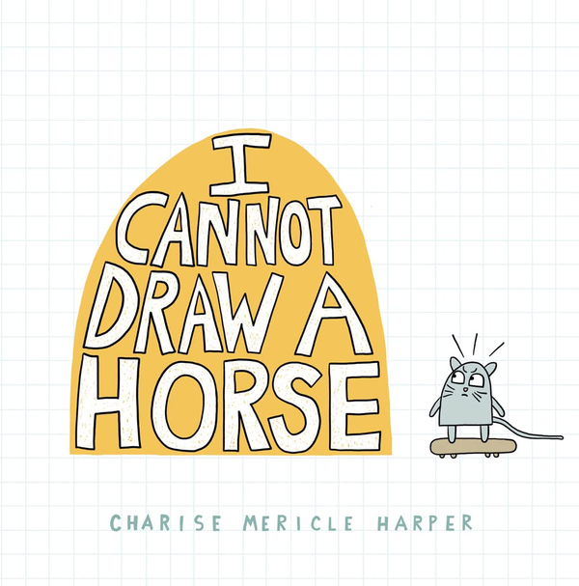
I CANNOT DRAW A HORSE
Author:
Illustrator:
Charise Mericle Harper
Charise Mericle Harper
Elementary-aged readers will delight as the simple “nothing shape” becomes a cat, a squirrel, a beaver, a bunny, a dog, a turtle, and a bear. But what about a horse? The cat really wants a horse. But . . . the book cannot draw a horse. Can the quick-draw book appease the horse-obsessed cat with an impressive collection of horse-y alternatives (all created from the same “nothing shape”)? Or will the cat finally get a horse?
picture book fiction | 48p
AR: LG | 1.6 | 0.5 pts

Slide 12

I’M TERRIFIED OF BATH TIME
Author:
Illustrator:
Simon Rich
Tom Toro
And so begins a hilarious dip into the choppy waters of a nightly ritual that parents and children alike often dread. Filled with soapsuds, rubber duckies, and existential angst, Simon Rich’s debut picture book is a splashy tale of cleanliness—and survival. This irreverent read-aloud treat about facing fear and embracing adventure might just change the way you see bath time (and your bathroom) forever.
picture book fiction | 40p
AR: none as of 9/24

Slide 13
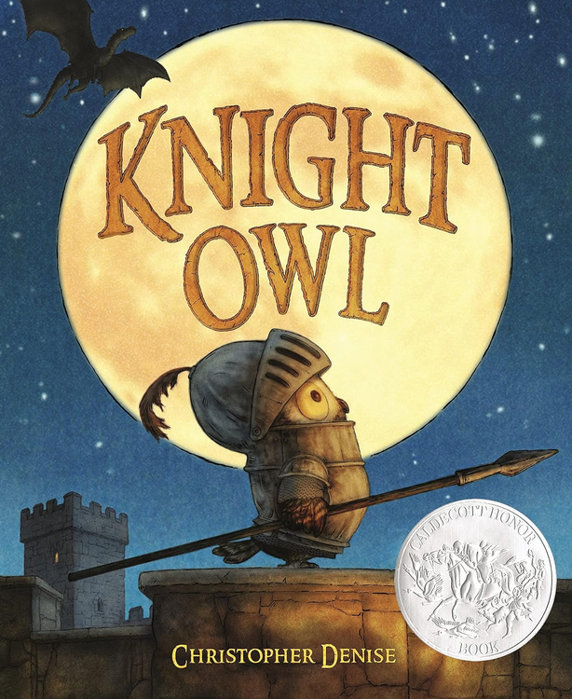
KNIGHT OWL
Author:
Illustrator:
Christopher Denise
Christopher Denise
Since the day he hatched, Owl dreamed of becoming a real knight. He may not be the biggest or the strongest, but his sharp nocturnal instincts can help protect the castle, especially since many knights have recently gone missing. While holding guard during Knight Night Watch, Owl is faced with the ultimate trial—a frightening intruder. It’s a daunting duel by any measure. But what Owl lacks in size, he makes up for in good ideas.
picture book fiction | 48p
AR: LG | 2.6 | 0.5 pts

Slide 14
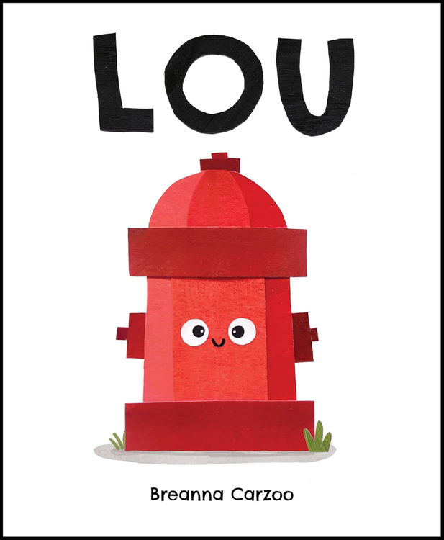
LOU
A PICTURE BOOK ABOUT A FIRE HYDRANT & UNLIKELY NEIGHBORHOOD HERO
Author:
Illustrator:
Brenna Carzoo
Brenna Carzoo
Meet Lou. Lou has an important job . . . as the neighborhood toilet. Useful as he may be, he gets the feeling that deep down inside, there might be more to him than that. He just doesn’t seem to know exactly what yet. When disaster strikes, will Lou find out what he’s made of and save the day?
picture book fiction | 32p
AR: LG | 1.6 | 0.5 pts

Slide 15

THE PET POTATO
Author:
Illustrator:
Josh Lacey
Momoko Abe
Potatoes can't do anything a pet should. They can't learn tricks, go for walks, or snuggle up with Albert.
But to Albert's surprise, his potato begins to grow on him, and soon he can't imagine having any other pet.
When the potato begins to rot, Albert is devastated. He buries it in his garden, and with a lot of care and a bit of patience, he discovers that his potato can do a great trick after all . . .
picture book fiction | 32p
AR: none as of 9/2024

Slide 16
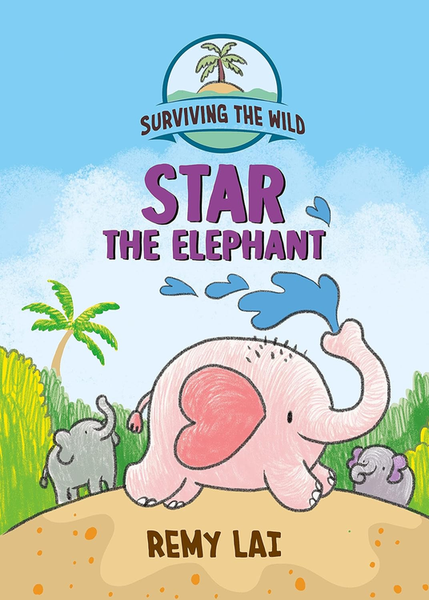
SURVIVING THE WILD
STAR THE ELEPHANT
Author:
Illustrator:
Remi Lai
Remi Lai
Star the Elephant and his herd are searching for a new home. But when Star is separated from his family, he must journey alone into the great unknown. He'll come face to face with giant spiders, the vast ocean beyond his island, and strange humans. Can Star find his way back to his family? In addition to the rich narrative and irresistible art, backmatter will describe the true story that inspired the book, animal facts, and steps kids can take to help protect the environment.
picture book fiction | 112p
AR: LG | 2.3 | 0.5 pts

Slide 17
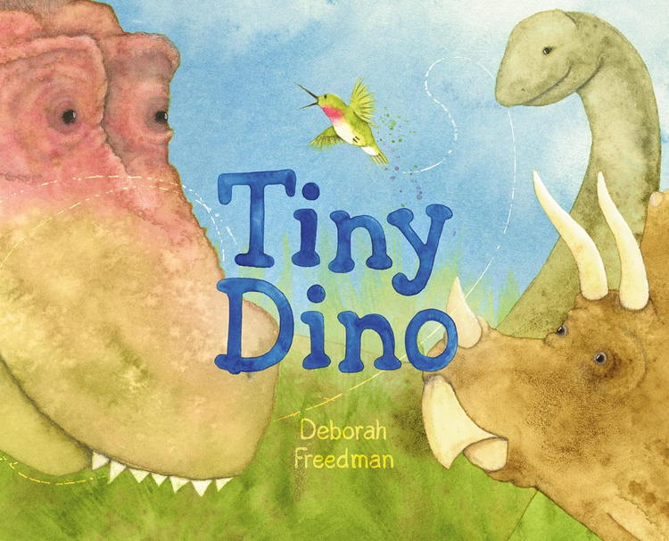
TINY DINO
Author:
Illustrator:
Deborah Freedman
Deborah Freedman
A small but mighty bird declares it is a dinosaur! But no one believes that dinosaurs still exist. How can it be a dinosaur when it is so little? Dinosaurs didn’t have feathers . . . or did they? This tiny dino is here to explain to its animal friends that birds are, in fact, dinosaurs, and all creatures are connected to one big animal family. With a playful ensemble of animal characters and dynamic bursts of dialogue, celebrated author and illustrator Deborah Freedman has created a spirited and informative picture book for dinosaur lovers of all ages.
picture book fiction | 40p
AR: LG | 2.0 | 0.5 pts

