Slide 1


LOUISIANA YOUNG READERS’ CHOICE
3rd Grade - 5th Grade
2024 - 2025

Slide 2




LYRC IS SPONSORED BY:
Louisiana Chapters of
Delta Sigma Theta
Sorority, Inc.

Slide 3
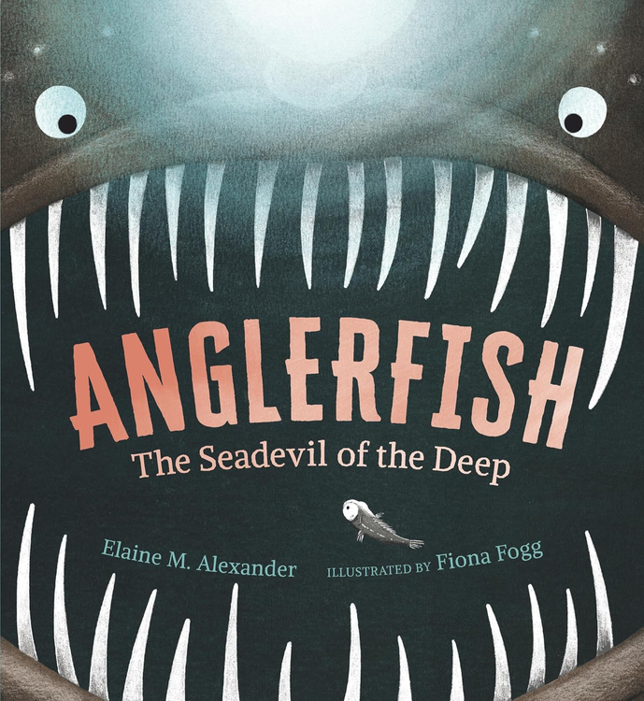
ANGLERFISH
THE SEADEVIL OF THE DEEP
Author:
Illustrator:
Elaine M. Alexander
Fiona Fogg
Dive thirteen thousand feet below the ocean’s surface, where no ray of sunlight can penetrate. Resources are scarce, and fellow inhabitants scarcer. This is life in the midnight zone—life for the anglerfish, known as the Seadevil of the Deep. Still largely a mystery to scientists, the deep-sea anglerfish is a true source of fascination and awe. To some, the fish resembles a prehistoric creature forgotten by time; to others, she is the embodiment of power, grace, and grit, using her remarkable physical attributes and a talent for deception to survive one of the harshest environments on the planet.
picture book nonfiction | 32p
AR: LG | 5.4 | 0.5 pts

Slide 4

BLUE
A HISTORY OF THE COLOR AS DEEP AS THE SEA & AS WIDE AS THE SKY
Author:
Illustrator:
Nana Ekua Brew-Hammond
Daniel Minter
For centuries, blue powders and dyes were some of the most sought-after materials in the world. Ancient Afghan painters ground mass quantities of sapphire rocks to use for their paints, while snails were harvested in Eurasia for the tiny amounts of blue that their bodies would release.
And then there was indigo, which was so valuable that American plantations grew it as a cash crop on the backs of African slaves. It wasn't until 1905, when Adolf von Baeyer created a chemical blue dye, that blue could be used for anything and everything--most notably that uniform of workers everywhere, blue jeans.
picture book nonfiction | 40p
AR: LG | 5.6 | 0.5 pts

Slide 5

CURVE & FLOW
THE ELEGANT VISION OF L.A. ARCHITECT PAUL R. WILLIAMS
Author:
Illustrator:
Andrea J. Loney
Keith Mallett
As an orphaned Black boy growing up in America in the early 1900s, Paul R. Williams became obsessed by the concept of "home." He not only dreamed of building his own home, he turned his dreams into drawings. Defying the odds and breaking down the wall of racism, Williams was able to curve around the obstacles in his way to become a world-renowned architect. He designed homes for the biggest celebrities of the day, such as Frank Sinatra and Lucille Ball, and created a number of buildings in Los Angeles that are now considered landmarks.
picture book nonfiction | 48p
AR: none as of 9/2024

Slide 6

ENDLESSLY EVER AFTER
Author:
Illustrator:
Laurel Snyder
Dan Santat
Grab your basket and your coat. Put on some walking shoes.
Turn the page and begin: Which story will you choose?
Award-winning creators Laurel Snyder and Dan Santat transform a crowd of classic tales into an ever-changing, fascinating, laugh-out-loud choose-your-path picture book, in which you may find a sleeping maiden, waste away in a sticky licorice cage, discover the gold at the end of a wild goose chase, or maybe (just maybe) save yourself—and the day!
picture book fiction | 92p
AR: none as of 9/2024

Slide 7

THE GARDENER OF ALCATRAZ
Author:
Illustrator:
Emma Bland Smith
Jenn Ely
When Elliott Michener was locked away in Alcatraz for counterfeiting, he was determined to defy the odds and bust out. But when he got a job tending the prison garden, a funny thing happened. He found new interests and skills--and a sense of dignity and fulfillment. Elliott transformed Alcatraz Island, and the island transformed him.
Told with empathy and a storyteller's flair, Elliott's story is funny, touching, and unexpectedly relevant. Back matter about the history of Alcatraz and the US prison system today invites meaningful discussion.
picture book nonfiction | 40p
AR: MG | 3.8 | 0.5 pts

Slide 8
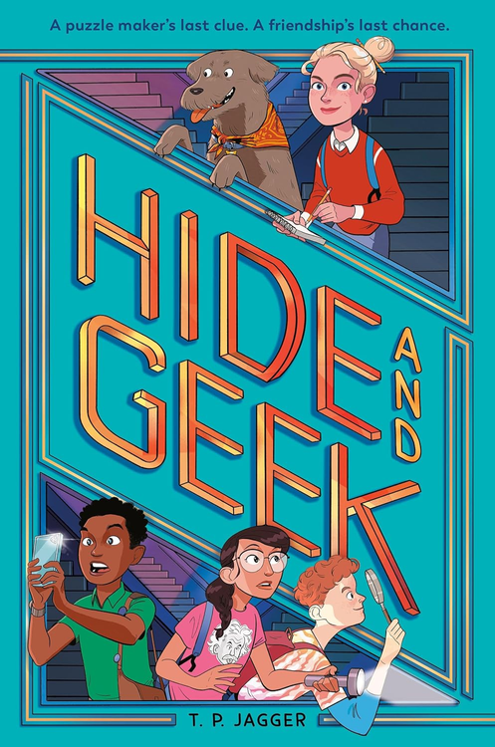
HIDE AND GEEK
Author:
T.P. Jagger
The GEEKs: Gina, Edgar, Elena, and Kevin have been best friends for as long as they can remember. So when their arch-nemesis points out that their initials make them literally GEEKs, they decide to go with it.
The problem: The GEEKs’ hometown of Elmwood was once the headquarters of the famous toymaker Maxine Van Houten. Her popular puzzle sphere, the Bamboozler, put the town on the map. But Maxine passed away long ago. Now the toy factory is shutting down, and Elena’s mom and Kevin’s dad are losing their jobs. They might have to move—and that would mean splitting up the GEEKs!
The quest: Maxine left one final puzzle, a treasure hunt that could save the town and keep the friends together. But only those who know and love Elmwood best will be able to solve it. GEEKs to the rescue!
mystery | 320p
AR: MG | 5.0 | 9 pts

Slide 9

JUST RIGHT JILLIAN
Author:
Nicole D. Collier
Fifth-grader Jillian will do just about anything to blend in, including staying quiet even when she has the right answer. After she loses a classroom competition because she won't speak up, she sets her mind on winning her school's biggest competition. But breaking out of her shell is easier said than done, and Jillian has only a month to keep her promise to her grandmother and prove to herself that she can speak up and show everyone her true self.
realistic fiction | 224p
AR: MG | 3.8 | 6 pts

Slide 10

JUST WILD ENOUGH
MIREYA MAYOR, PRIMATOLOGIST
Author:
Illustrator:
Marta Magellan
Clémentine Rocheron
For Mireya Mayor, even as a young child whose house was filed with cats, dogs, rabbits, birds, a chicken, and a snapping turtle, nothing was quite wild enough. Older, she traded her pom-poms as a cheerleader for the National Football League for the swamps of the South American jungle. The first woman wildlife TV reporter for National Geographic, she traveled the world, but things still weren't quite wild enough. It was only when Mireya went to Madagascar that things FINALLY got wild enough. This biography of the woman who convinced the prime minister of Madagascar to make the mouse lemur’s rain forest a protected national park is an inspiring—and wild story.
picture book nonfiction | 32p
AR: none as of 9/2024

Slide 11
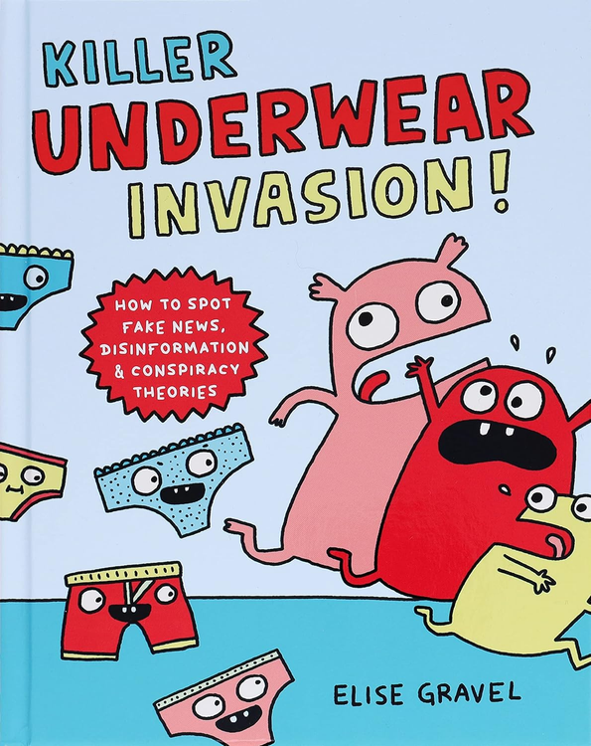
KILLER UNDERWEAR INVASION
HOW TO SPOT FAKE NEWS, DISINFORMATION & CONSPIRACY THEORIES
Author:
Illustrator:
Elise Gravel
Elise Gravel
Can peanuts give you super strength? Were unicorns discovered on the moon? Did Martians really invade New Jersey? For anyone who has ever encountered outrageous stories like these and wondered whether they were true, this funny, yet informative book breaks down what fake news is, why people spread it, and how to tell what is true and what isn’t.
graphic nonfiction | 104p
AR: MG | 3.6 | 0.5 pts

Slide 12

LISTEN
HOW EVELYN GLENNIE, A DEAF GIRL, CHANGED PERCUSSION
Author:
Illustrator:
Shannon Stocker
Devon Holzwarth
"No. You can't," people said. But Evelyn knew she could. She had found her own way to listen.
From the moment Evelyn Glennie heard her first note, music held her heart. She played the piano by ear at age eight, and the clarinet by age ten. But soon, the nerves in her ears began to deteriorate, and Evelyn was told that, as a deaf girl, she could never be a musician. What sounds Evelyn couldn’t hear with her ears, though, she could feel resonate through her body as if she, herself, were a drum. And the music she created was extraordinary. Evelyn Glennie had learned how to listen in a new way. And soon, the world was listening too.
picture book nonfiction | 40p
AR: LG | 3.7 | 0.5 pts

Slide 13

MAIZY CHEN’S LAST CHANCE
Author:
Lisa Yee
Maizy has never been to Last Chance, Minnesota . . . until now. Her mom’s plan is just to stay for a couple weeks, until her grandfather gets better. But plans change, and as Maizy spends more time in Last Chance (where she and her family are the only Asian Americans) and at the Golden Palace—the restaurant that’s been in her family for generations—she makes some discoveries. For instance:
You can tell a LOT about someone by the way they order food.
And people can surprise you. Sometimes in good ways, sometimes in disappointing ways. And the Golden Palace has secrets.
But the more Maizy discovers, the more questions she has. Like, why are her mom and her grandmother always fighting? Who are the people in the photographs on the office wall? And when she discovers that a beloved family treasure has gone missing—and someone has left a racist note—Maizy decides it’s time to find the answers.
realistic fiction | 288p
AR: MG | 4.6 | 6 pts

Slide 14

NOUR’S SECRET LIBRARY
Author:
Illustrator:
Wafa' Tarnowska
Vali Mintzi
Forced to take shelter when their Syrian city is plagued with bombings, young Nour and her cousin begin to bravely build a secret underground library. Based on the author's own life experience and inspired by a true story, Nour's Secret Library is about the power of books to heal, transport and create safe spaces during difficult times.
Illustrations by Romanian artist Vali Mintzi superimpose the colorful world the children construct over black-and-white charcoal depictions of the battered city.
picture book fiction | 32p
AR: LG | 7.7 | 0.5 pts

Slide 15
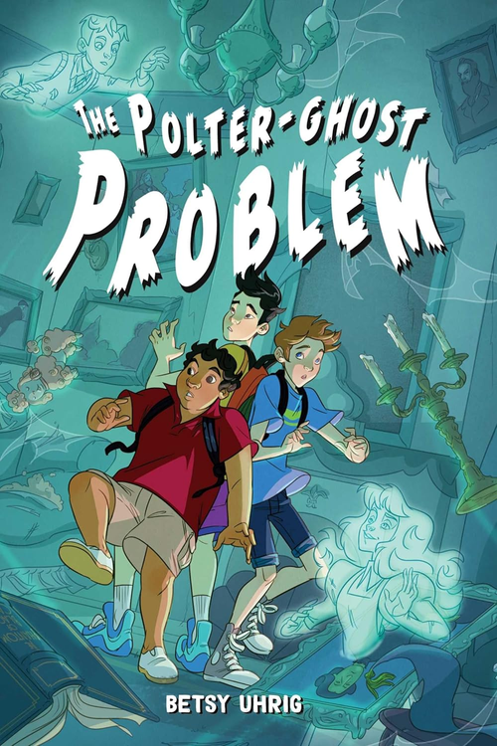
THE POLTER-GHOST PROBLEM
Author:
Betsy Uhrig
One haunted orphanage + two types of ghosts + three freaked-out friends = plenty of trouble.
Best friends Aldo, Pen, and Jasper are braced for a boring summer. And equally dull summer journal writing assignments. That is, until they see a slightly transparent boy with a bad haircut appear by the soccer field and then disappear into the woods beyond. The boys follow him and discover the long-abandoned Grauche Orphanage for Orphans, a house in the woods that is most definitely haunted.
But the ghosts are not the problem. They have been trapped at the orphanage by a cranky poltergeist who erupts into violent tantrums if they put even a spectral toe across the property line. The ghosts ask the boys to help free them—but who is the angry poltergeist and what does it want? To solve the mystery, the trio must investigate the orphanage’s dark past, evade Aldo’s ghastly older brother, borrow a skeptical librarian, and duck lots of flying furniture, all while failing to agree on almost anything.
mystery | 288p
AR: MG | 5.1 | 8 pts

Slide 16

SORT OF SUPER
Author:
Illustrator:
Eric Gapstur
Eric Gapstur
11-year-old Wyatt Flynn had something amazing happen to him: he got superpowers! Good ones too, like super-flight, super-strength, and super-speed. The only problem? Wyatt got his superpowers totally by mistake, and his dad—who’s been overprotective since Wyatt’s mom disappeared—thinks he’s too young for them and worries what would happen if everyone found out. So he makes Wyatt hide his powers.
Keeping such a huge secret from his best friends Beto and Nara is bad enough, but not being able to use his new abilities to defend them from the biggest bully at school makes Wyatt feel useless and frustrated. But his little sister thinks the good his powers could do is more important than following Dad’s rules. Slowly, the two of them become a dynamic crime-fighting duo right under their dad’s nose.
Lying to his dad isn’t much easier than lying to his friends. But Wyatt might be able to make a real difference in the community…and maybe even find Mom. That makes it all worth it—right?
graphic novel | 240p
AR: MG | 2.9 | 1 pt

Slide 17
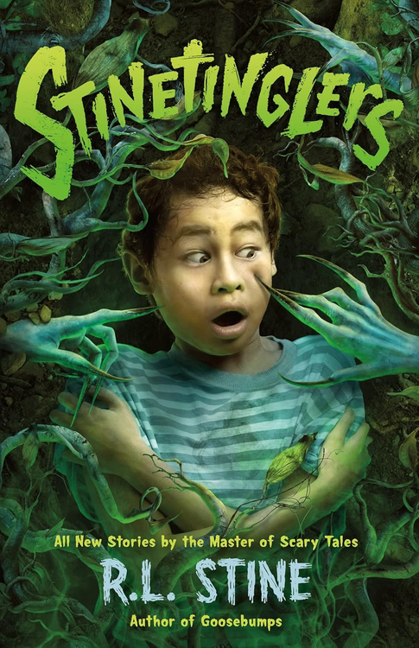
STINETINGLERS
Author:
Illustrator:
R.L. Stine
David SanAngelo
From R.L. Stine, the master of horror for young readers, comes ten new stories that are sure to leave you shivering. A boy who hates bugs starts to see them everywhere. A basketball player’s skin starts to almost drip off his hands—but no one else can see it. Three friends find a hole in the ground that just gets bigger, and bigger, and bigger . . . And each story is introduced by Stine himself, providing a personal touch sure to delight fans.
Laced with Stine’s signature humor and a hefty dose of nightmarish fun, Stinetinglers is perfect for fans of Scary Stories to Tell in the Dark and Stine’s own Goosebumps books. These chilling tales prove that Stine’s epic legacy in the horror genre is justly earned. Dive in, and beware: you might be sleeping with the lights on tonight!
horror | 224p
AR: MG | 3.5 | 6 pts

